Slide 1
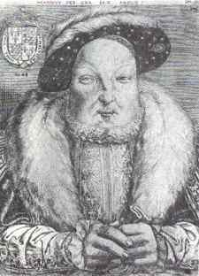
Faction at the Court of Henry VIII 1540-47 - A Sometimes Deadly Pursuit

Slide 2
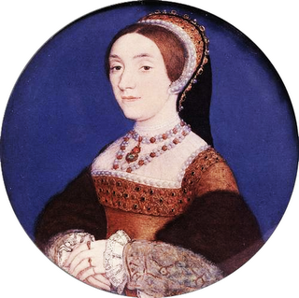
Episode 1:1541
There seems to be proof of Catherine Howard’s adultery, November 1541
Opportunity? (Reformers)

Slide 3
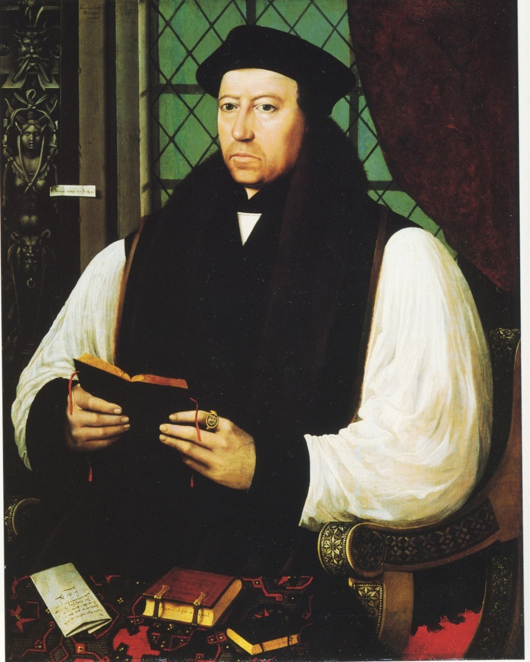
Episode 2: 1543
The so-called Prebendearies Plot.
There are reports of heresy from the Cathedral Chapter at Canterbury.
Opportunity (Conservatives – Germayne Gardiner)
Response (Cranmer)

Slide 4
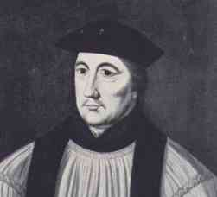
Episode 3: 1544
Germayne Gardiner, nephew and secretary to Stephen Gardiner, has been executed for denying the royal supremacy (accused of colluding with Reginald Pole)
Opportunity (Reformers)
Response (Gardiner)

Slide 5
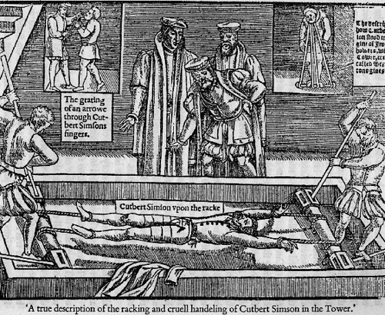
Episode 4: Summer 1546
A Lincolnshire woman Anne Askew has been arrested on a charge of heresy. She has admitted to heresy bur her interrogators, Sir Richard Rich and Sir Thomas Wriothesley, attempt to incriminate other members of the Court and torture Askew, suggesting that she is a member of a larger heretic cell which includes the Countess of Hertford and the wife of Sir Anthony Denny and also associates of the Queen.
Opportunity (Conservatives)
Response (Catherine Parr)

Slide 6
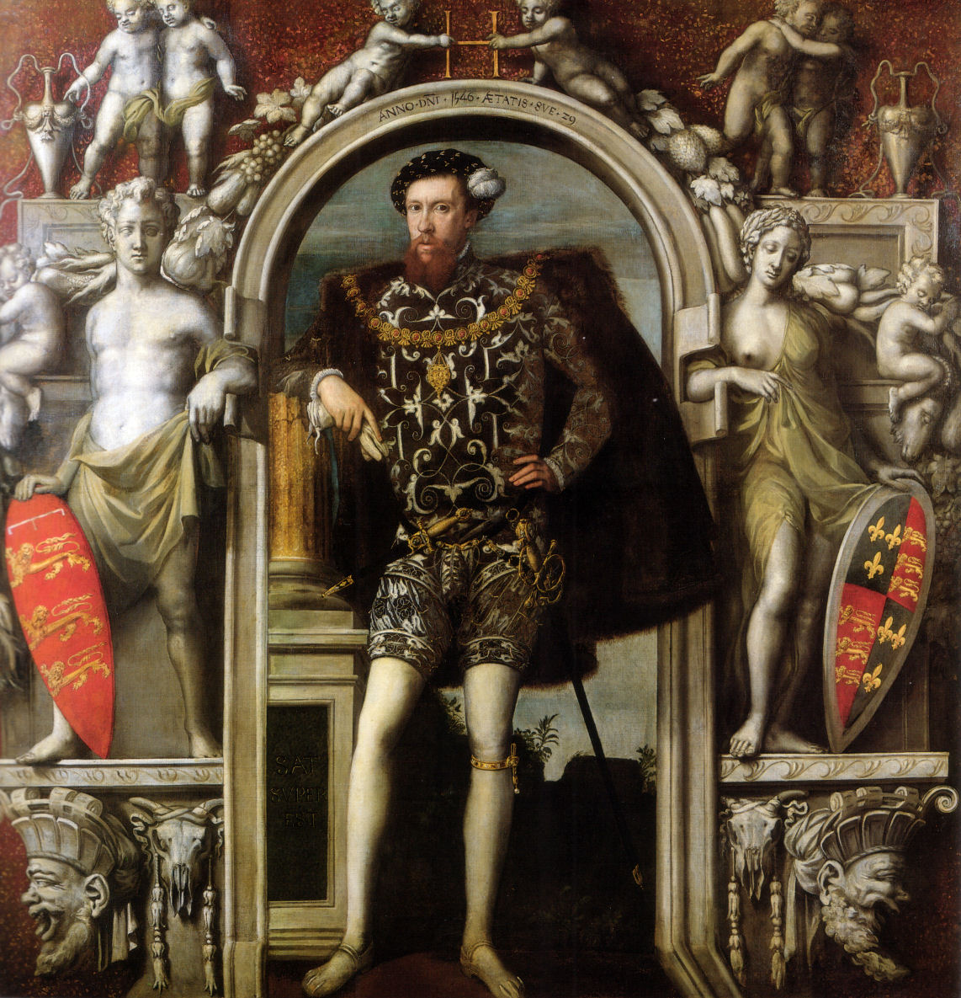
Episode 5: December 1546
Henry Howard, Earl of Surrey and the son of Thomas Howard, Duke of Norfolk, has experienced failure as a military commander and is showing touches of hubris. He defence of Boulogne earlier in the year against the French was unconvincing. He has been arguing that his own family should have a prominent role in governing the realm during the minority of Edward VI and even worse has spliced his coat of arms with those of Edward the Confessor.
Opportunity (Reformers)
Response (Hertford)

Slide 7
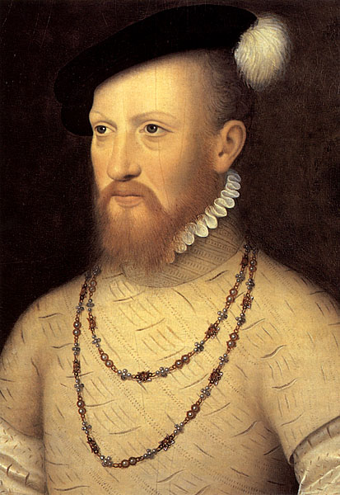
Episode 6: December 1546 – January 1547
Henry VIII is dying. The reign of his son and heir Edward will shortly begin. Via his client Sir Anthony Denny, Edward Seymour controls the Privy Chamber.
Opportunity (Hertford): what instructions to whom do you give to do what? How will this benefit you and your faction?

Slide 8
Lessons
What have you learnt from this exercise about faction at the court of Henry VIII in the years 1540 to 1547?
What can this particular exercise not tell you about the process of faction at Henry’s court between 1540 and 1547?

