Slide 1
Starter activity
What are the key differences between evangelical and catholic belief/practice?
Identify at least 4 key differences

Slide 2
The church 1536-1547
– Change or Continuity?

Slide 3
Catholic vs Protestant
The position of the pope
the number of sacraments
The role of bishops
The availability of the bible – in Latin or English?
The religious role of monasteries
The look of churches (e.g. the use of images)
Influential figures within the church
Belief in transubstantiation and purgatory
The role of preaching
Emphasis on faith rather than works

Slide 4
Graphing the Reformation
Use the timeline on pp. 116-118 of SHP
Plot a graph to get an overview of the tension between Catholic and Evangelical teaching in the church of England.
  0 = out and out Catholic
  5 = a balance of Catholic and Protestantism
  10 =out-and-out Protestantism

Slide 5
Homework Question
‘The government of Henry VIII did not significantly change the doctrine of the Church of England between 1537 and 1547’.
Explain why you agree or disagree with this view.
Really this is a question about whether there was a Reformation.

Slide 6
The Debate
The very idea of a Reformation in England under Henry is challenged by Christopher Haig:
  It is a ‘conceptual sham’ as Christopher Haigh suggests, ‘so theologically half-baked that it ought not to be called a Reformation at all’.
  Runs counter to the traditional view (e.g. A.G. Dickens) that a Reformation did take place (but of course!).

Slide 7
Task
Go through the list of religious actions…
Which suggest evangelical reform, which maintaining catholicism?
Which items are ecclesiological, doctrinal or liturgical (i.e. to do with services).
Which changes (where there is change) might be considered packaging rather than substance?

Slide 8
Tensions and Ambiguities
You need to be aware that there is some debate over some measures.
The Act of Ten Articles does not represent a rejection of four of the sacraments – it just doesn’t mention them.
Yet Latimer and Shaxton’s resignation after the Act of Six Articles suggests that they really did see it as a U-turn.
The Dissolution of the Monasteries looks like a protestant measure, and perhaps it was from Cromwell’s point of view. But from Henry’s perspective it was Erasmian and it was financial. You didn’t need to be a protestant to dissolve monasteries.
Yet the dissolution of the monasteries and the later Chantries Act served to undermine the doctrine of purgatory in practice even if in theory it was never completely rejected. Henry himself was still ordering masses for his soul in the 1530s and 1540s.

Slide 9
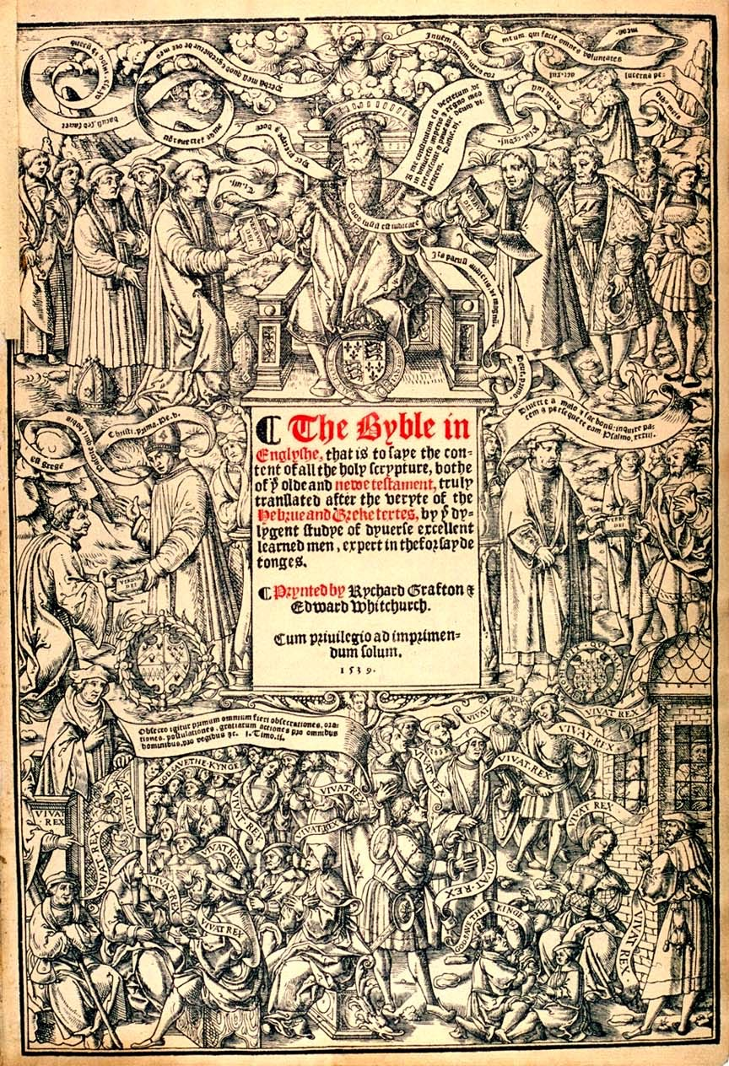
What is Henry doing?

Slide 10
Haec me constitutum est decretum ut in universo imperio et regno meo tremiscant et pareant deum -
This has been decreed so that everyone in my entire kingdom and empire might fear and obey the living God.

Slide 11
Interpreting what Henry is doing
What Henry wanted was a settlement between the evangelical bishops he had appointed (like Shaxton, Latimer, Ridley, Cranmer) on the one hand and the conservatives (like Cuthbert Tunstall and Stephen Gardiner) on the other.
He wants stability.
Henry was worried about the implications of protestant teaching for his realm… particularly the idea that salvation comes by faith alone (which suggests no need for a mediator of any kind… and that the believer has direct access to God).
For Henry salvation comes not by faith alone but by obedience to the word of God – handed down by God to Henry and then to his bishops.
Henry’s emphasis on the authority of scripture was already clear in the debate about the annulment (his appeals to Leviticus as above even papal dispensation.)
This is why the English Bible was not mere packaging but substance… and it is also why he wanted to restrict access to it.
Obedience to the word of God means obedience to the king.
Henry sees himself as the Old Testament King David… priest and king – this is why he takes such I
It is about reform – but it is Erasmian rather than Lutheran reform…
But it also about power and control…

Slide 12
Reformation
A Difficult concept
Is the idea of a Henrician reformation a conceptual sham (Christopher Haig)?
NO – there clearly was a Reformation but it was more ecclesiological and liturgical than doctrinal.
It is clearly reform from above, not from below (an official rather than a popular Reformation)…
It represents a VIA MEDIA – a middle path between Rome and Luther.
Bernard: ‘This is a man who is absorbed into the intellectual and theological world of Erasmian humanism’

Slide 13
Next steps
Essay should be structured in two halves.
One half concerned to show there was change (i.e. yes there was a Reformation)…
The second half to say there wasn’t
Introduction/Conclusion – was there a reformation? Yes in some senses, but not in another…
Make use of technical vocabulary – ecclesiological, theological/doctrinal, liturgical;
What was Henry doing?
He was clearly evangelically inclined in some ways but not in others…
It was about Reform – but it was also about power and control: the two go hand in hand for him.

