Slide 1
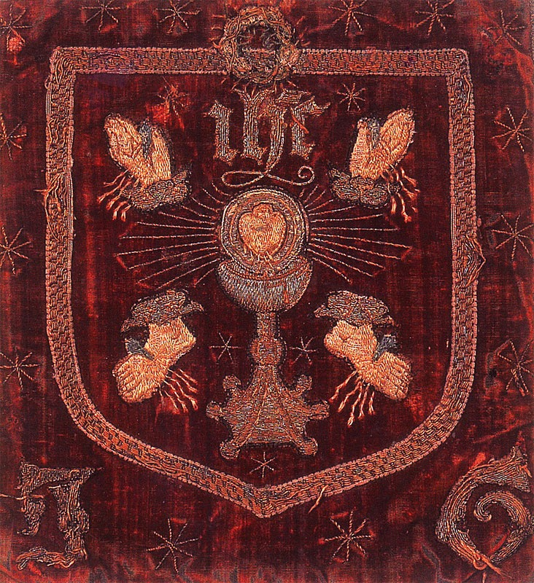
The Pilgrimage of Grace
Why did the Pilgrimage arise?
What were the outcomes?

Slide 2
Debate
The debate about the Pilgrimage of Grace concerns its motivation and its leadership. Was it driven by religious or secular (i.e. political/economic) concerns? Was it planned and orchestrated by Lords Hussey and Darcy, the defeated members of the Aragonese faction or was it a spontaneous, popular uprising?
Geoffrey Elton (1983) - The protest was essentially religious and political, led by the defeated Aragonese faction at court; and in support of this he pointed to the key roles played by Lords Darcy and Hussey who had been supporters of Catherine.
Stephen Gunn (1989) - Hussey lacked the necessary political clout to have orchestrated such a rebellion; the key role was played by the yeomen and tradespeople, followed by the clergy.
Michael Bush (1996) - For Bush, the protest was popular and economic aimed at protecting the ‘commonwealth’ - the ‘commons’ and ‘material good of the realm’ from unfair and heavy taxation, from the Statute of Uses and from attacks on the wealth of local churches (i.e. their material rather than their ‘spiritual aspect’).

Slide 3
Was the Pilgrimage Secular or Religious?
Patrick Collinson argues that this question has been badly framed:
  ‘The religious/secular dichotomy is modern and anachronistic, tending to overlook the threefold role of religion in movements of this kind: precipitation, bonding and legitimation…. To restrict ‘religion’ in the 16th century to matters ‘spiritual’ and to ‘Catholic idealism’… is myopic and misses the point.’
George W. Bernard would go further – it is not merely that religion precipitated and legitimated a revolt whose participants were bonded by religion.
Bernard argues that the cause of the revolt was fundamentally a religious one – first and foremost to do with the suppression of the monasteries and secondly to do with other legislation that brought about the break with Rome and the royal supremacy.
Only this explains why the revolt occurred when it occurred, too the form that it did, and received the articulation that it did in the voice of participants like Robert Aske.

Slide 4
Patrick Collinson
Were the common people sufficiently well-informed and organised to have a politics of their own, to launch on their own volition something on the scale of the Lincolnshire Rebellion and the Pilgrimage of Grace?
And how did their objectives and initiatives interrelate and interact with the interests of their social betters, the nobility and gentry who constituted the upper echelons of local and regional government in Tudor England?
The nobility who became involved in the Pilgrimage claimed to have been coerced into their leadership roles. Was Elton right to be sceptical?
Beyond these questions lies another: what was the nature of the relationships which bound the social orders into a commonwealth which only occasionally, as in 1536, became dysfunctional?

Slide 5
Background
Until 1536, the measures taken to secure the break with Rome and the Royal supremacy did not affect the practice of religion in England to any great extent.
The same could not be said about the Act to Dissolve the Smaller Monasteries and the Injunctions to the Clergy of 1536, which effected a virtual abolition of Saints’ Days (reducing these to one) and discouraged pilgrimage.
Holy days and pilgrimages were part of the life of all English men and women: more than any measures taken until now these measures would affect everyone directly.

Slide 6
Lincolnshire risings and oath swearing
The risings began in Louth, Lincolnshire, but soon sprang up all over the north of England. Louth, Lincolnshire - the people inspired by the local clergy and a shoemaker known as Captain Cobbler, rose to defend their parish church. They took the Bishop of Lincoln’s registrar prisoner as he was about to conduct a visitation of the local clergy.
On October 4th, in Horncastle, the Bishop of Lincoln’s Chancellor was lynched and killed by the mob. This atrocity suggests that the revolt was not planned by Lord Hussey, as Elton suggested, but was indeed a spontaneous popular uprising within which some members of the nobility got caught up when threatened.
The commons seem to have spent a great deal of their energy nobility by means of oaths – perhaps a reaction to Henry VIII’s policy of oath swearing in 1534. The wording of the oaths imposed on the bishop’s steward, on the rich men of Louth, and then on the Lincolnshire gentry suggests again the religious nature of the rising and its commoner origins – ‘to be true to almighty God, to Christ’s Catholic church, to our sovereign lord the king and unto the commons of this realm so help you God.’
Anthony Irby, a JP of Holland, reported how the gentleman of Holland had reported had been compelled by some commons at Boston to swear ‘to be true to God and the king, the commons and the common wealth.’ The implication in these oaths was that the current policies of the government were not true to God, the catholic church, the king and the commons. Bernard writes ‘the Linconshire rebels were speaking the language of religious crusade, of tax revolt.’

Slide 7
The banner of the rebels
Besides the evidence of the oaths, the symbols chosen emphasise the essentially religious nature of the rising.
The rebels wore the badge of the 5 wounds of Christ, believing they were engaged in a crusade to repotted the Church and to reverse the reforms. Elton points out that this was Lord Darcy’s personal emblem.
Others included a plough beside the religious symbol – which suggests again the lowly origins of the rebellion.
Loyalists, Sir Marmaduke Constable and Sir Robert Tyrwhit, reported to Cromwell that what the commons petitioned and wished the king to offer was first a pardon and then ‘that they may keep their holydays fair day and offerings day according to their old customs and that all religious houses being suppressed may stand and that his grace shall ask no more money of them also that they would fain have you.’
They carried out a book burning of translations of the bible and writings by English reformers.

Slide 8
Early demands
According to Thomas Bradley, subprior of Barlings, George Staines read a proclamation to the assembled rebel host at Lincoln on Sunday 8th October saying in his first article ‘that he should be messenger to the king’s highness in the name of them all.’ The King would be asked:
  ‘that he should ask no money of them for taxes and taleings and that no more monasteries nor churches should be suppressed or pulled down and that his highness should take noble men to his council and remove from him the Lord Crowell and the chancellor of the augmentations and certain heretic bishops as the bishop of Lincoln , the archbishop of Canterbury the bishop of Saint Davids and other which proclamation was made in diverse places that day’.
  The implication is that the king has been led astray by his councillors – who were heretics.
Given that questioning the Royal Supremacy was treasonable, it is perhaps not surprising that this was not explicitly mentioned in the early drafts of the articles, but the religious concerns are nonetheless clear and run contrary to royal policy since 1529.
The Lincolshire uprising lasted about two weeks before dispersing in fear of an assault by the Earl of Shrewsbury.

Slide 9
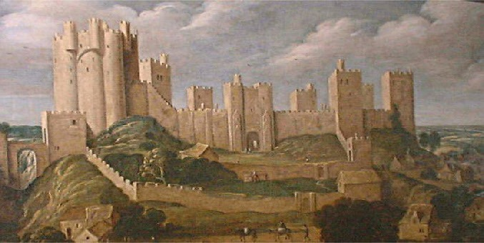
Yorkshire risings
Similar complaints were voiced in Yorkshire, and a similar strategy of forcing gentry to swear oaths, including the lawyer, Robert Aske who agreed to voice the complaints against the destruction of the abbeys and the ‘new men’ around the king.
Once again, Elton suggested that the defeated Aragonese faction lay behind the rising – this time Lord Darcy Thomas (1467-1537) who owned lands in Yorkshire and Lincolnshire and gave up one of the most significant strongholds in Northern England - Pontefract Castle - because he said it was too badly provisioned to withstand a siege.
That Darcy sympathised with the rebels is clear, but to say he secretly organised the Yorkshire rebellion credits him with more personal influence in the region than he held by virtue of his position as constable of Pontefract Castle.
Darcy refused to surrender Aske to the king
but saw his actions as loyal to the king’s best
Interests.

Slide 10
The extent and nature of the opposition
It was in Yorkshire that the name ‘pilgrimage for grace’ first arose – a title that bears witness to the essentially religious – even crusading – character of the rebellion. Once again, the swearing of an oath was central to the rebellion and to its spreading.
Robert Aske formulated the oath (‘You shall not enter to this our Pilgrimage for the common wealth but only for the love ye bear to God’s faith and church militant and the maintenance thereof…’) which describes the pilgrimage as ‘for the commonwealth’. Thus the interests of the ‘commonwealth’ and the church are the same – and not separate as some commentators have argued, somewhat anachronistically. The oath made the point that is only for love the church and not for any private profit that a person enters the Pilgrimage for the commonwealth.
By December, 30,000 armed men assembled on the banks of the River Don near Doncaster under the leadership of Aske, were met by Norfolk who realised that his 8000 troops would be no match for the rebel army.
Similar complaints were being voiced in Cornwall, so it was fortunate for the king that a rebellion did not arise there.
To make matters worse, there were rumours that the rebellion within England might be co-ordinated with an imperial/papal invasion from the Continent. Cardinal Reginald Pole, a descendent of the Yorkist kings (and though never a claimant, was more directly descended from Plantagenet blood than Henry) appeared in Calais under instruction from the pope.

Slide 11
The Pontefract Articles or Commons’ Petition
In December 1536, the Pilgrimage of Grace rebels, led by Robert Aske, met at Pontefract Castle (Dec. 2-4) to draft a petition of "demands" to be presented to King Henry VIII. This list of "24 Articles", sometimes called "The Commons' Petition", was given to the Duke of Norfolk at Doncaster on December 6th.
The rebels agreed to disband if the King reviewed the demands, a freely elected parliament at York would act on the same, and if the rebels received parliamentary pardon for taking part in the rebellion and for all acts committed during the same.

Slide 12
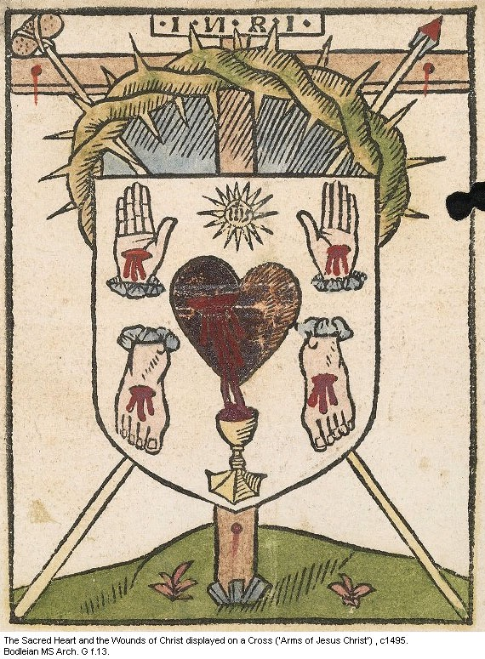
The York Articles
The York Articles sent to the Mayor, by Aske claimed that the ‘suppression of so many religious houses’ was of ‘grete hurt to the common wealth.’
Article 4 complained about the activities of Cromwell and Rich, the Chancellor of Augmentations.
Article 5 attacked reforming bishops, especially Cranmer, Shaxton, Latimer and Longland.

Slide 13
The Pontefract Articles
Religious grievances head the list:
  Article 1 condemned the heresies of Luther, Wycliffe, Tyndale, Barnes and the Anabaptists.
  Articles 4 and 6 sought to reverse the suppression of the monasteries and in particular of the Observant Friars.
  Religious grievances were closely connected with political ones:
  Article 2 wanted to see the papal headship of the church restored ‘as before it was accustomed to be’, even though the same article upheld the ban on payments of first fruits to Rome.
  Article 3 wished to see Mary restored to the succession, indicating their belief that the Aragonese marriage was valid.
  Articles 7 and 8 attacked Cromwell and Rich as ‘maintayners of the false sect of heretiques’, but also because they were low born - and were resented by the nobility in the way that Wolsey had been.
  Article 11 demanded punishment for Legh and Layton, Cromwell’s commissioners.

Slide 14
Economic and social demands
Finally, the articles also gave a prominent place to economic and social concerns, although the distinctions between economic, social and religious concerns are perhaps clearer to our eyes than they would have been to the rebels.
  Article 13 was concerned to restrict enclosures, which had turned arable land into pasture, thereby reducing the numbers who could live off such land.
  Article 14 complained against taxes were too high (a standard complaint)
  Article 18 demanded the Church’s rights of sanctuary to be confirmed by an Act of Parliament (in fact, in 1540 just the opposite occurred).
  Article 19 demanded liberties (ability to run courts, enforce law etc.) returned (a 1536 Act had restored all such powers to the crown).
  Article 20 demanded the repeal of the Statute of Uses of 1536, which restricted the ability of gentry and peers to provide for younger sons without paying fines to the Crown.

Slide 15
Elite or popular/planned or spontaneous?
Clearly many of the demands that were included in the Pontefract articles reflect the interests not of the commons but of the aristocracy.
How do we explain this?
Patrick Collinson argues that the rebellion was popular and spontaneous but was designed to bring on board some of the aristocracy – who were at best ‘neutral’ and generally sympathetic. By taking charge of the insurrection they recovered their natural role of leadership and used that to secure their own interests. They knew – as did the king –this was about ‘damage limitation’.
The position of the Crown was far from hopeless. Many of the gentry were not consistent in their support. Henry Percy, Sixth Earl of Northumberland, for example, encouraged the rebellion only indirectly. Four of the rebel captains, Aske, Stapleton, Constable, Lascelles, were members of his council, but he did not lead the rebellion himself. The Percies were enemies with Henry Clifford, Earl of Cumbria, so were unlikely to build a common front.

Slide 16
The destruction of the rebels in 1537
Norfolk received the articles with promises to present them to the King. He also promised a parliament at York and a general pardon to the rebels.
Robert Aske announced these promises to the Pilgrims, and the rebels disbanded. Aske visited the King in London, but returned to York in January with nothing more than vague promises.
In January 1537, a new uprising was started under Sir Francis Bigod, who had realized the King had no intention of respecting either the Pilgrims' demands, or the promises made to them. Bigod was a surprising participant - he had previously written in criticism of the wealth of monasteries and had been one of Cromwell’s commissioners. His rebellion amounted to little and he was captured in Cumberland before being sent to Tyburn for execution.
This gave the King an excuse to violently stamp out the rebellion in the North and to renege on the promises made on his behalf by Norfolk.
The Duke of Norfolk returned North and proclaimed martial law. Groups of rebels were hanged in Cumberland, while gentry leaders were rounded up and taken to London where some 178 people, including Aske and Darcy were executed.

Slide 17
John Aske’s defence and historical debate
Under arrest in April 1537, Aske was questioned in detail. It was put to him that false rumours had been the cause of the revolt, and it was reported: ‘He thinks those bruits were one of the greatest causes, but the suppression of abbeys was the greatest cause of the said insurrection, which the hearts of the commons most grudged at, as he saith.’
Michael Bush presented Aske’s defence of the monasteries as an essentially social economic document – stressing the rebels’ material objections to the dissolution – notably its impact on employment, charity and hospitality.
R. W. Hoyle similarly emphasises the material ‘apart from the loss of divine service, the reduced number of masses and Aske’s evident distate for the sacrilegious treatment of church ornaments and fabric, this is an apologia for monasteries couched in utilitarian social and economic terms.
C.S.L. Davies sees opposition to the dissolution as reflecting fears of local impoverishment, as rents would be paid to the king and not spent locally, and of a general attack on local impoverishment, as rents would be paid to the king and not spent locally, and of a general attack on local institutions.’

Slide 18
G.W. Bernard response
G. W. Bernard argues ‘the problem with such an approach is that it implicitly redefines religious matters so as to exclude the charitable, hospitable and educational role intrinsic to late medieval monasteries… Moreover it would be a gross distortion to read Aske’s defence of the monasteries as in any sense unmindful of their first responsibility, the divine service for almighty God. Aske was rather emphasizing how much the monasteries did in the north and what damaging effects the suppression was having on the local economy. In stressing their broader activities, he may also have been attempting to persuade a king who and ministers who, as he would have grasped by now, were not committed to the traditional religious functions of monasteries.

Slide 19
Outcomes
No parliament was created. After the execution of Thomas Percy at Tyburn in July 1537, the lands of the 6th Earl of Northumberland (Henry Percy, who remained loyal) escheated to Henry VIII, a permanent Council of the North was established.
The Council was staffed by loyal servants, but included a number of Pilgrim leaders - e.g. Robert Bowes and Sir Ralph Ellerker (who claimed - as did others who were not so fortunate - that he had only joined the rebels under duress).
Promises to restore the monasteries failed to materialise so that even the largest was destroyed by 1540. However, when Henry dissolved the chantries in the south of England in the 1540s he did not touch those in the north.
The main principles of Catholicism were restated in the Act of Six Articles of 1539 - albeit this was a Catholicism without monasteries or pilgrimage.
The Statute of Wills of 1540 overturned the Statute of Uses, and recognised the rights of landowners to dispose of property. It restricted the amount of taxation which the king could claim when the right to use land was inherited. This effectively gave those who used the land part ownership in the property.
In 1540 Cromwell was removed from power and in 1543 Mary was restored to the succession.

Slide 20
Dissolution of the monasteries
Far from halting the dissolution of the monasteries the Pilgrimage of Grace added to Henry’s resolve.

Slide 21
How significant was the Pilgrimage of Grace?
Elton (1956) - The Pilgrimage of Grace was never anything but a futile attempt to arrest the power of the revolution to which Henry had given his suport since 1533. The Pilgrimage collapsed far too quickly to justify the common view of it as a genuine mass movement eager to overthrow a howls system and policy. The King and his Council knew what was happening - the executions in the North indicated that they did not think they were confronted by a peasants’ war, or by a feudal conflict, or by a resistance movement involving a whole society.
MacCulloch and Fletcher (2004) - Given the combination of protest from a wide geographical spectrum of northern society, it is easy to see why the Pilgrimage could have been fatal for Henry’s government: it cam perilously close to succeeding, and was the largest popular revolt in English History. If more leading noblemen in the north had backed it, all would have been lost for those attempting to reform religion around Cromwell in London.

Slide 22
Conclusions
  Key sources for the motives behind the Pilgrimage include the York and Pontefract Articles listing the demands of the Pilgrims – and these appear to have been religious, political and economic, but it would be anachronistic to assume that these distinctions would have been made by contemporaries who clearly understood the entire uprising in religious terms.
  Rumour appears to have played a key role in initiating the rebellion, and these focused principally on three areas, all of them to do with religion: that a total dissolution of the monasteries was intended; that the king was going to radically reduce the number of parish churches; and that the material fabric of those churches – in particular precious metals used in processional crosses and chalices – was going to be confiscated.
  Very prominent in the artcles are specifically religious demands, including restoration of dissolved monasteries, the restoration of papal supremacy on the one hand, and condemnation of reforming bishops and Lutheran and Anabaptist heresies on the other. The word ‘Pilgrimage’ is itself religious, and had been under attack in the injunctions of 1536. Revolt flared up wherever monasteries were being dissolved - monks and priests were often foremost in stirring up the crowds. Sixteen out of fifty five suppressed monasteries were restored during the revolt.

Slide 23
Conclusions
  There were apparently political complaints, including demands for Cromwell and Richard Rich to be removed from the King’s council, for the abolition of the Court of Augmentations and for commissioners Layton and Leigh to be punished. These might reflect resentment of men of low birth advising the king, but what connected them was their role in the divorce and the subsequent religious policies.
  Connected with the political complaints were economic and social concerns arising directly from parliamentary acts concerning taxation, the recent abolition of Franchises and Liberties and a demand for the repeal of the Statute of Uses – all of which were products of parliamentary acts in 1534 and 1536, and for which again Cromwell must have held key responsibility.
  These reflected the interests of the higher classes that joined the rebellion who – perhaps realising that a complete reversal of the religious revolution was unlikely -sought some restoration of the status quo in their favour.

