Slide 1
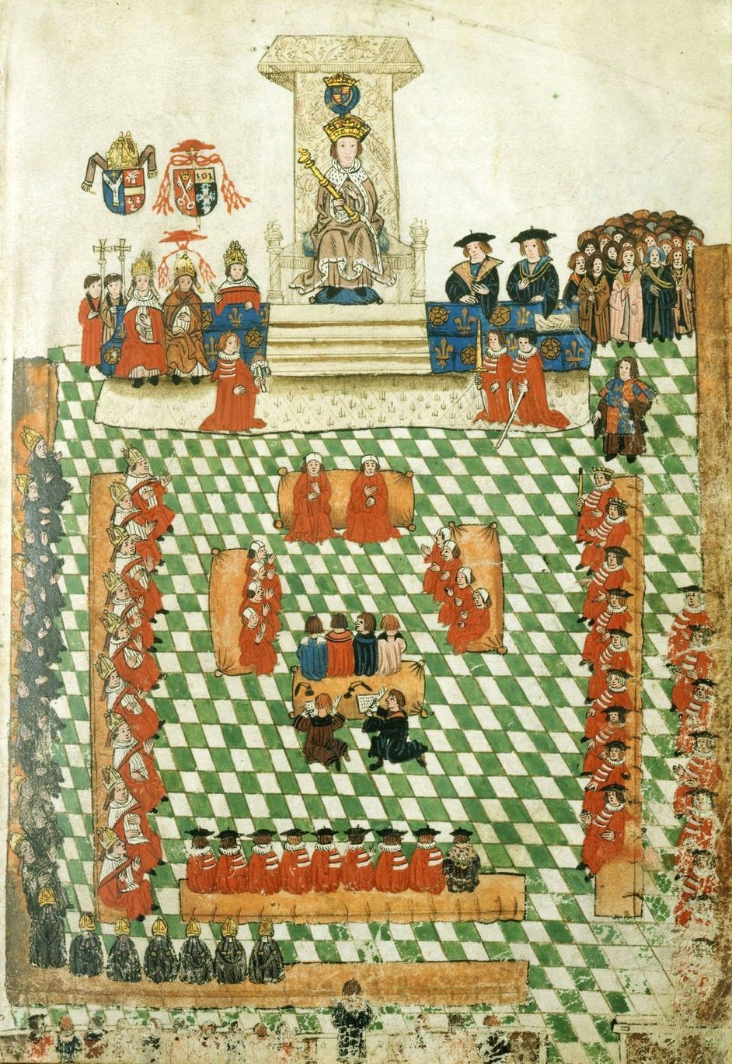
Phase 3 – The Reformation Parliament and preparations for the divorce
Key question:
How did Henry prepare for the divorce between 1529-32?
Was the period between 1529 and 1531 one of drift or one of attack?
Starter: Think, Pair, Share
What was the role of parliament for a late medieval/early Tudor monarch?
What is the difference between an Act of Parliament and a declaration of the King?

Slide 2
Debate: drift or preparation?
Geoffrey Elton – period late 1529 to 1531 is a period of drift. King Hal is a bumbler without Wolsey. Doesn’t quite know what to do…
  Elton makes a lot of the gap between 1529 and the Acts of Parliament in 1532.
J. Scarisbrick (and more recently and particularly G.W. Bernard) are much less critical of Henry. Bernard in particular sees Henry pursuing a two-pronged strategy: get the pope to agree, and prepare the ground for a break with Rome if he doesn’t.
  For Scrisbrick and Bernard the gap between 1529 and end of 1531 is essential. Henry is doing the delaying now but it is quite deliberate whilst he builds a case that may lead to the most momentous change in English ecclesiastical history.

Slide 3

The Reformation Parliament 1529-32
The Rise of Thomas Cromwell
Having just failed to attain his goal by means of the strategy pursued by Wolsey, Henry turned his attention in 1529 to Parliament.
English monarchs usually only called parliament when they needed money – and with reluctance.
They could raise taxation with the help of their nobility – but only if the latter got something in return.
Henry’s previous parliaments – 1512, 1514 and 1523 were concerned with money for war and with enclosures.
Parliament of 1523

Slide 4
Parliament in 1529
It wasn’t at first clear what Henry wanted from parliament when he called it in 1529, although many wanted to raise an Act of Attainder against Thomas Wolsey.
In an unprecented move, Henry allowed ‘free speech’ at this parliament and a number of voices were heard criticising abuses within the Church.
This first parliament passes ‘reform’ measures against abuses of which Wolsey was chief perpetrator and beneficiary - in particular, against pluralism, non-residency, mortuary and probate fees.
Acts were passed to regulate Probate and Mortuary, and to end Benefit of Clergy – reflecting the criticism of secular lawyers, particularly following the Richard Hunne Case of 1514.
Parliament

Slide 5
1529-30
1529-30
Frontal attack
The criticisms of abuses – such as pluralism, absenteeism – allowed Henry’s agents in Rome to claim that Henry and only Henry could prevent Parliament from demanding reform, but Parliament then went into recess
Meanwhile, Boleyn clients – Thomas Cranmer and John Foxe suggest seeking out the views of theology schools around Europe
The results in the Collectanea Satis Copiosa presented to Henry in September 1530
  Collected sources included:
    Marsilius of Padau
    Christopher of St Germain
Henry now had the theoretical basis for breaking with Rome and establishing (or confirming as he would see it) the Royal Supremacy.
    A much edited, abbreviated version of this work was produced in 1531 known as ‘A Glass of Truth’ which can be seen as the beginning of a propaganda/pamphlet assault on papal supremacy.

Slide 6
Praemunire charge
Frontal attack
In November 1530, Henry brought charges of Treason against Wolsey and Praemunire against 15 clergy not because they opposed his divorce case, but because they had accepted Wolsey as papal legate – a clear sign that, following the Collectanea – Henry was willing to ‘up the ante’ against the church and ultimately against the pope.
This Praemunire charge was then outrageously extended to the rest of the clergy in December.
Had Henry already committed to a policy of breaking with Rome? Or was he merely trying to pressure the pope to give him what he wanted? It seems likely that Henry was pursuing a twin-track policy, with his preference being the easier route – of the Pope giving him what he wanted.

Slide 7
Thomas Cromwell
The Rise of Thomas Cromwell
At some point during this second phase, between 1529 and 1532, Thomas Cromwell went from being Wolsey’s trusted assistant to the king’s man in parliament.
Remarkably – and unlike other servants of Wolsey, particularly Stephen Gardiner – Cromwell remained loyal to Wolsey, defending him against the attainder against him in Parliament in 1529 and negotiating with the king on his behalf throughout 1530.
Perhaps it was Cromwell’s loyalty that Henry admired, but in any case, Cromwell was invited to join the king’s council before the end of 1530.
Some historians – e.g. Elton, Randall – credit Cromwell with direction of the king’s policy.
G.W. Bernard, The King’s Reformation (2005) argues that Henry is in charge and has clear ideas about what he wants from an early stage.

Slide 8
Submission of the Clergy 1531
Frontal attack
Henry made clear that he would withdraw the church if the Church would provide £119,000 (roughly equal to the annual income of the crown) and agree to his title being changed to ‘Supreme Head of the church in England and Wales’.
The Submission of the Clergy agreed to the title with the addition of the words ‘so far as the law of Christ allows’.
This was a compromise – and one that seemed to satisfy both sides, for the time being at least.
Henry waited, but nothing changed and in the Spring of 1532 he upped the ante yet again.

Slide 9
Act to remove annates 1532
The first clear and direct challenge to the pope was the bill to remove the payment of annates (monetary payments made by English bishops to the church in Rome from their first year’s income from their diocese).
It struck at the main source of revenue that the Church in Rome received from England.
The First Act – is 1532 – conditional (enabling) Annates are payments made to the papacy as a condition of consecration – but there was more to this than merely a threat to cut off a revenue to Rome.
By threatening to ban payment of annates is to suggest that Pope is not the CONSECRATOR of English clerical appointments.
However, neither the Act to Remove Annates - which was eventually passed with some opposition in the House of Commons - did not sway the pope who may have assumed that Henry would have reverted to the status quo ante bellum once his obsession with Anne Boleyn had passed.

Slide 10
Supplication of the Ordinaries, 1532
March 1532 Members of parliament petitioned Henry to take action against the way in which churchmen abused their powers.
Even before this point, Henry presented the Convocation of the Church in England with two demands:
    They should surrender the right to pass new canon law
  All future changes in canon law would require the consent of the king.
At a stretch… this could be seen as merely an extension of the historical position of the church in England which had always claimed a degree of independence but it was not seen by Henry’s clergy or by his Lord chancellor in this light.

Slide 11
A turning point?
The submission of the clergy on 15th May 1532 might be seen as a key turning point.
Thomas More, the Lord Chancellor, certainly thought so, because he ‘resigned’ the next day 16th May – or at least, that is what he claimed.
Why did it matter so much?
Effectively, the Church had given up its legal independence.
It could no longer produce canon law without royal approval.
All current canon law had to be scrutinized by royal advisers.
In effect, Henry had taken the penultimate step to breaking with Rome.

Slide 12
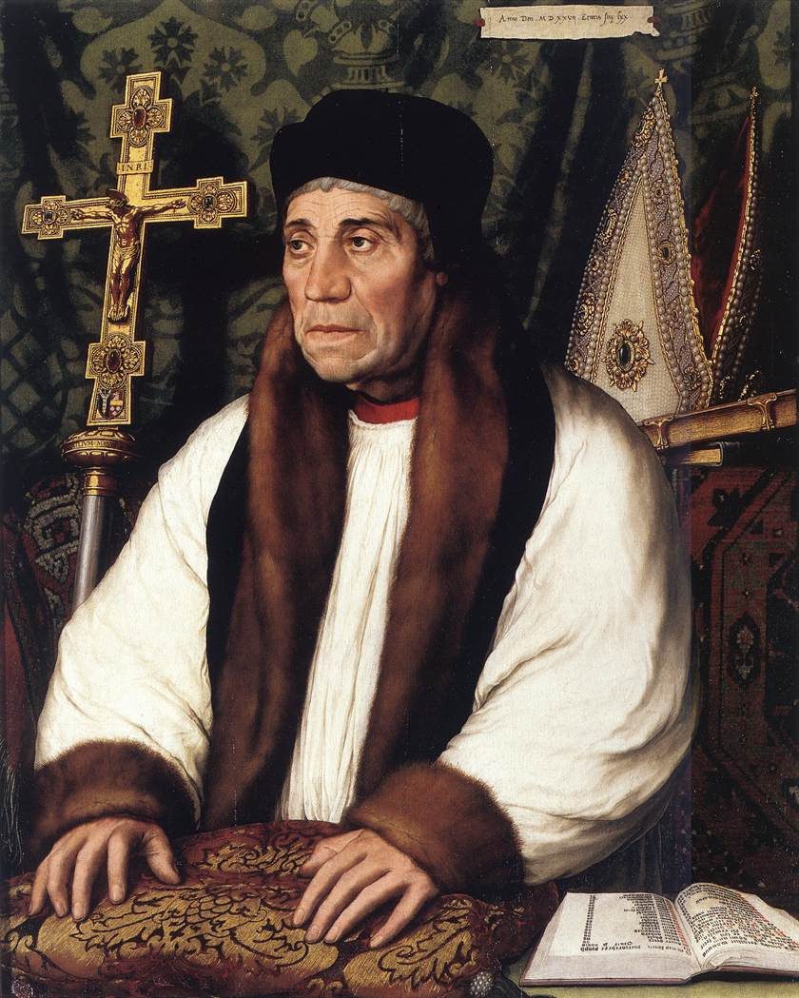
The Death of Warham, August 1532
The death of Archibshop Warham removed another potential obstacle.
Having secured the submission of the Convocation of the church of England, could pronounce on his divorce.
The pregnancy of Anne Boleyn, during the trip to Calais to meet with Francis I is often seen as the catalyst for the events that led to the final phase – the actual break with Rome – but it seems clear that Henry’s decision to sleep with Anne Boleyn (or her with him) followed the secure belief that the divorce would now be granted – either by the pope or as seemed increasingly likely – by Henry’s own clergy.

