Slide 1
WWII and the British Mandate in Palestine
The 1939 White Paper
Jewish and Arab responses
The Holocaust and its impact

Slide 2
Continued Jewish Immigration
Despite the Arab revolt and the rejection of the Peel Commission’s recommendations, the Jewish population in Palestine continued to grow between 1936 and 1939.
By 1939 there were nearly 450,000 Jews, almost a third of the entire population.
This provides the backdrop to the British government’s proposed solution.
The McDonald Report was compiled and recommendations were made to the government in the form of a White Paper.

Slide 3
The MacDonald Report
The policy, first drafted in March 1939, was prepared by the British government unilaterally as a result of the failure of the Arab-Zionist London Conference.
The paper called for the establishment of a Jewish national home within an independent Palestinian state within 10 years.
It rejected the idea of a creating a Jewish state and of partition as unworkable.
It proposed strict limitations to Jewish immigration and a unified state in which Arab Palestinians would be in control.
The British appear to have moved closer to the Arab position at a time when its strategic position in the Middle East was threatened by the prospect of war with Germany.

Slide 4
The White Paper of 1939
Although never formally approved, the White Paper acted as the governing policy for Mandatory Palestine between 1939 and 1945.
Jewish immigration was limited to 15,000 per year until 1944 but also made it contingent upon Arab consent thereafter.
It also limited Jewish immigration to 75,000 for 5 years (15,000/year), and ruled that further immigration was to be determined by the Arab majority (section III).
Restrictions were placed on the rights of Jews to buy land from Arabs.
It promised that only with Palestinian support would Britain allow a Jewish state.

Slide 5
Arab reaction
The Arab National Higher Committee initially argued that the independence of a future Palestinian state could not be guaranteed because Jews would withhold participation and prevents its functioning.
It also argued that limitations on Jewish immigration were not tight enough.
In June 1939 the Grand Mufti of Jerusalem, Hajj Amin al-Hussein initially turned down the paper.
However, it was eventually accepted after two weeks of negotiation the leader of delegates to the London Conference Jamal al-Husseini agreed to the terms of the white paper and signed it..

Slide 6
Zionist reaction
Zionist groups in Palestine immediately rejected the White Paper and began a campaign of attacks on government property and Arab civilians which lasted for several months. On 18 May a Jewish general strike was called.
On 27 February 1939, in response to enthusiastic Arab demonstrations following reports that the British were proposing to allow Palestine independence on the same terms as Iraq, a coordinated Irgun bombing campaign across the country killed 38 Arabs and wounded 44.
In response to the White Paper, the right-wing Zionist militant group Irgun began formulating plans for a rebellion to evict the British and establish an independent Jewish state.
Simultaneously, Zionist leaders in Western Europe and the United States would proclaim an independent Jewish state in Palestine, and would function as a government-in-exile.
Irgun seriously considered carrying out the plan, but was concerned over the heavy losses it would doubtless incur.
Irgun leader Avraham Stern (who would later break from Irgun to form Lehi), formed a plan for 40,000 armed Jewish fighters recruited in Europe to sail to Palestine and join the rebellion.
After the outbreak of war in September 1939, the head of the Jewish Agency for Palestine David Ben-Gurion declared: 'We will fight the White Paper as if there is no war, and fight the war as if there is no White Paper.'

Slide 7
Growing Jewish hostility to British rule
For Jews, the 1939 White Paper represented the deepest act of betrayal at the time of their greatest peril.
groups in Palestine immediately rejected it.
A Jewish general strike was called on 18th May.
The Jews able to escape the death camps of the Holocaust had nowhere to go.
At the Biltmore Conference in May 1942, Zionist Organizations called for the establishment of Palestine as a Jewish Commonwealth, thus claiming all of Palestine – a view that was already implicit in Jewish response to the Peel Partition in 1937.

Slide 8
Fighting on the British side
Despite their opposition to the White Paper, Jews enlisted in the British army.
Meanwhile, they also continued to resist the White Paper, through illegal immigration.
David Ben-Gurion said ‘We must fight the war as if there were no white paper, and fight the white paper as if there were no war.’

Slide 9
The mandate becomes ungovernable
The British were placed in an impossible situation – support immigration and they were turning the Arabs into a ‘landless nation’ and violence would increase; deny immigration and they were not doing enough to protect Jews from Nazi persecution.
The British did not implement all of the recommendations and whilst it tried to reduce immigration did not impose limits recommended by the White Paper.
Thereby the British managed to alienate both sides at once.

Slide 10
4 Key impacts of WWII
The Holocaust -
  Created International sympathy for the Jewish Cause Survivors and Zionists pushed harder for a state – as the only thing that could provide Jews with security.
  Led eventually to the creation of the Anglo-American Committee of Enquiry (or Anglo-American Commission) and the so-called Biltmore program.
  In particular, this brought both American and Russian intervention into the region in support of the creation of a independent Israeli state.

Slide 11
2. The Biltmore Program
American-Zionist network produced the Biltmore Program in 1942 calling for a Jewish state in Palestine;
Roosevelt, worried about Arab oil supplies during the war did not support it at first;
But in the 1944 presidential elections, keeping the ethnic vote in mind, both Democratic and Republican election platforms endorsed the Biltmore Program.

Slide 12
3. Jewish Terrorism
Before the Arab General Strike of 1936 it was the Jewish community that found itself the victims of sporadic violence.
Irgun and Lehi (also known as the ‘Stern Gang; after its founder) were founded during this period. (Haganah means ‘defence’; Irgun means ‘Second Defence’).
As well as Arab targets, Jewish terrorist attacks increased against British targets after 1939 as a direct result of the White Paper.

Slide 13
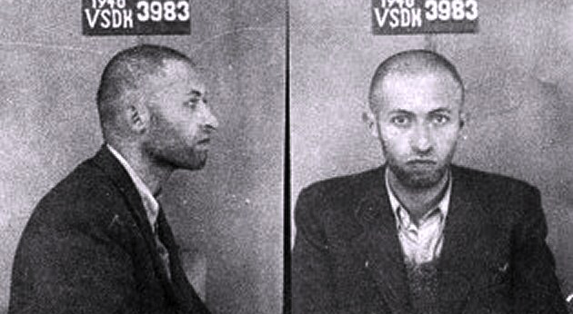
Menachem Begin – leader of Irgun - mugshot from 1940

Slide 14
4. Arab responses
Husseini support for Hitler:
  Mohammed Amin al-Husseini, who had formed the Arab Higher Committee in 1936, made contacts with Germany seeing the Nazis as a tool for ridding Palestine of both British and Zionists.
  In November 1941 he fled to Germany and met with Hitler and other leading Nazis
  Husseini helped the Nazis recruit 20,000 Bosnian Muslims into the SS who participated in the killing of Jews in Croatia and Hungary.

Slide 15
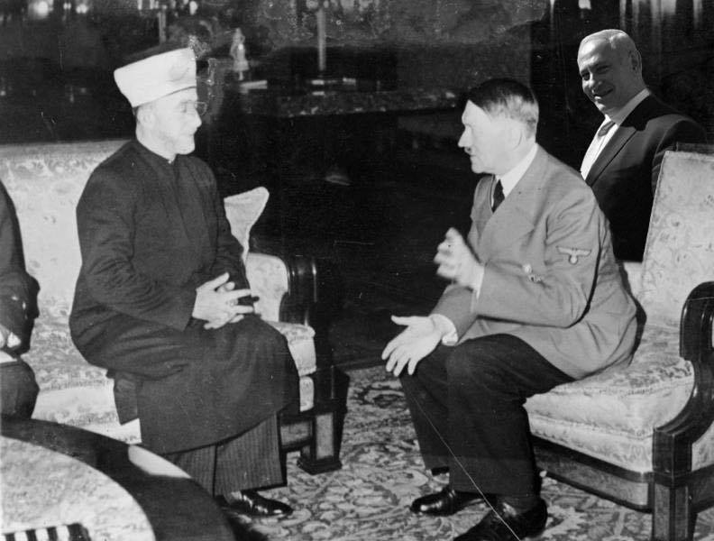

Slide 16
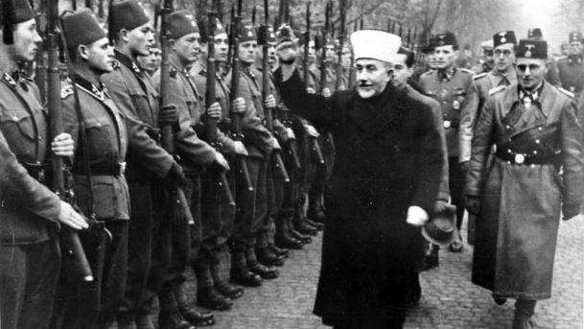
Husseini helped recruit Bosnian Muslims for the Waffen-SS

Slide 17
What should we have learned so far?
Importance of nationalism to both Zionists and Arabs; and conflict over land, resource and religion (physical and spiritual space);
Significance of the McMahon-Husseini correspondence (1915); Sykes-Picot agreement (1916) and the Balfour Declaration (1917).
The 1929 Wailing Wall incident and the Peel Commission of 1937;
5 key impacts of WWII
Reasons for the British hand over.

Slide 18
Key Questions
Why were Palestinian Arabs angry about Jews emigrating to Palestine after the First World War?
Why was Britain unable to establish an independent Palestine state ruled jointly by Arabs and Jews?
How did British attitudes to the mandate change between 1919 and 1945?
How did Jewish attitudes towards British rule change between 1919 and 1945?
Why did the Arabs rebel in 1936? Write a few sentences under the following headings:
  British promises during WWI
  The British mandate in Palestine
  Jewish immigration
How far did War change British policy in Palestine?

